Slide 1
SENTIMENT ANALYSIS OF AMAZON PRODUCT REVIEW 1998 – 2015 USING LOGISTIC REGRESSION
PREPARED AND PRESENTED
BY
EMMANUEL ESIVWENUGHWU

Slide 2
DATA SOURCES AND DESCRIPTION
1. https://www.kaggle.com/cynthiarempel/amazon-us-customer-reviews-dataset?select=amazon_reviews_us_Baby_v1_00.tsv
2. https://www.kaggle.com/cynthiarempel/amazon-us-customer-reviews-dataset?select=amazon_reviews_us_Electronics_v1_00.tsv
3. https://www.kaggle.com/cynthiarempel/amazon-us-customer-reviews-dataset?select=amazon_reviews_us_Office_Products_v1_00.tsv
4. https://www.kaggle.com/datasets/cynthiarempel/amazon-us-customer-reviews-dataset?select=amazon_reviews_us_Toys_v1_00.tsv

Slide 3
DATA SOURCES AND DESCRIPTION CONTINUED
Each of the dataset contains 15 similar columns with a total of over 9million records/rows, the columns are described below:
- marketplace: 2 letter country code of the marketplace where the review was written.
- customer_id: Random identifier that can be used to aggregate reviews written by a single author.
- review_id: The unique ID of the review.
- product_id: The unique Product ID the review pertains to. In the multilingual dataset the reviews for the same product in different countries can be grouped by the same productid.
- product_parent: Random identifier that can be used to aggregate reviews for the same product.
- product_title: Title of the product.
- product_category: Broad product category that can be used to group reviews (also used to group the dataset into coherent parts).

Slide 4
DATA SOURCES AND DESCRIPTION CONTINUED
- star_rating: The 1-5 star rating of the review.
- helpful_votes: Number of helpful votes.
- total_votes: Number of total votes the review received.
- vine: Review was written as part of the Vine program.
- verified_purchase: The review is on a verified purchase.
- review_headline: The title of the review.
- review_body: The review text.
- review_date: The date the review was written.

Slide 5
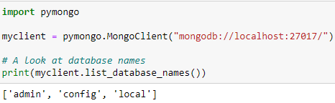
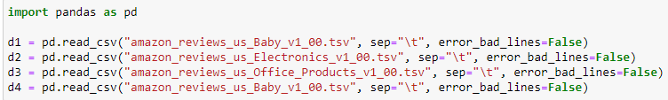
DATA LOADING AND DATA STORE (MONGODB)

Slide 6
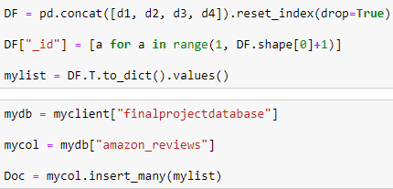

DATA LOADING AND DATA STORE (MONGODB) CONTINUED

Slide 7
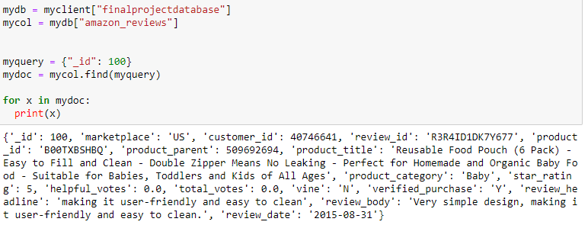
QUERY ON MONGODB

Slide 8
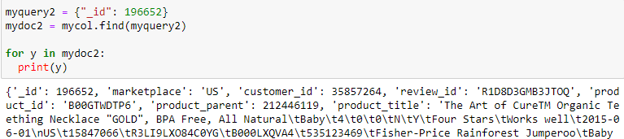

QUERY ON MONGODB CONTINUED

Slide 9
DATA LOADING AND DATA STORE (MONGODB)

Slide 10
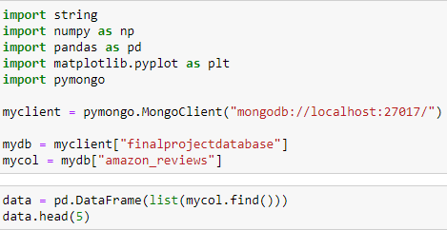
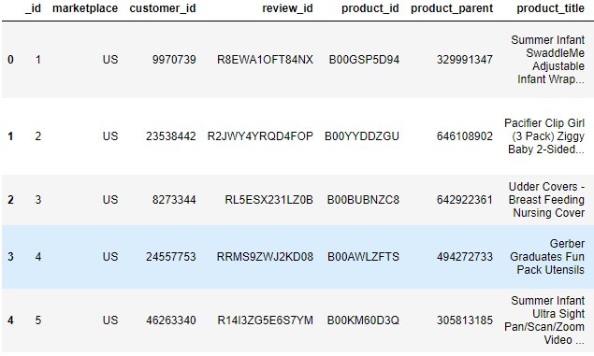
DATA CLEANING AND PREPARATION

Slide 11
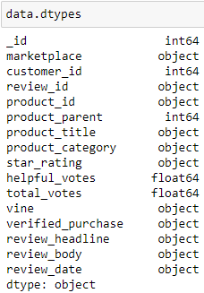
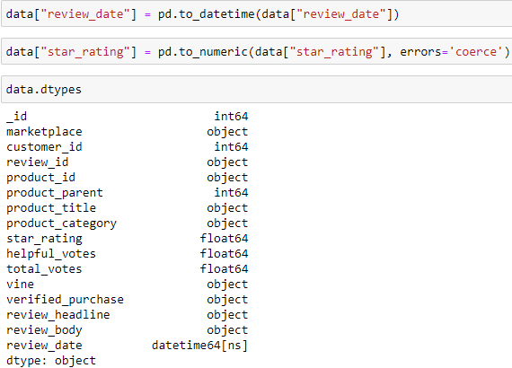
DATA CLEANING AND PREPARATION CONTINUED

Slide 12
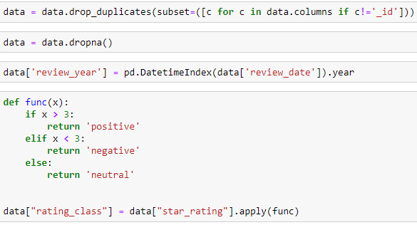
DATA CLEANING AND PREPARATION CONTINUED

Slide 13
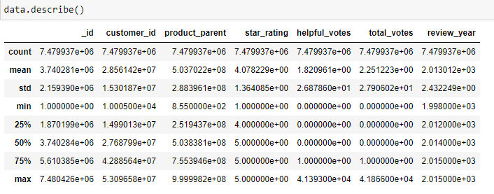
EXPLORATORY DATA ANALYSIS

Slide 14
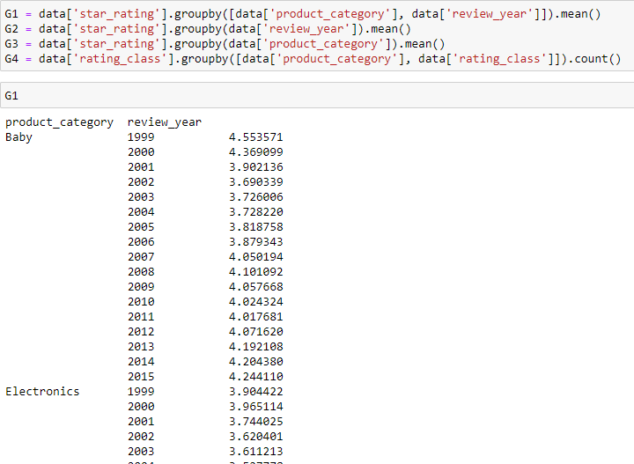
EXPLORATORY DATA ANALYSIS CONTINUED

Slide 15
EXPLORATORY DATA ANALYSIS CONTINUED

Slide 16
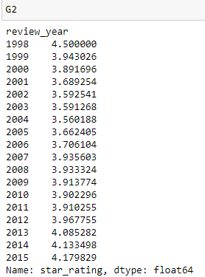
EXPLORATORY DATA ANALYSIS CONTINUED

Slide 17
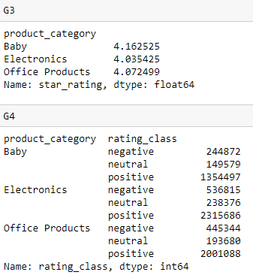
EXPLORATORY DATA ANALYSIS CONTINUED

Slide 18
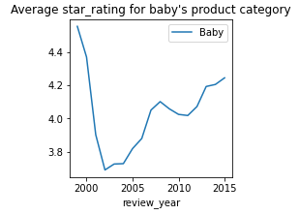
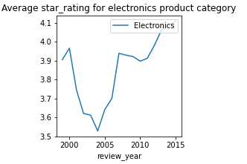
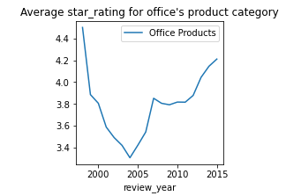
EXPLORATORY DATA ANALYSIS CONTINUED AVERAGE STAR RATING FROM 1998 – 2015 BY PRODUCT CATEGORY

Slide 19
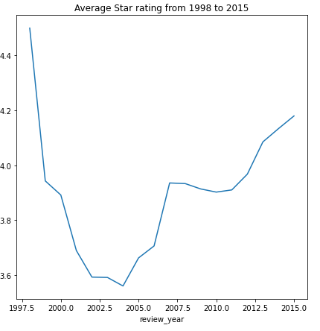
EXPLORATORY DATA ANALYSIS CONTINUED

Slide 20


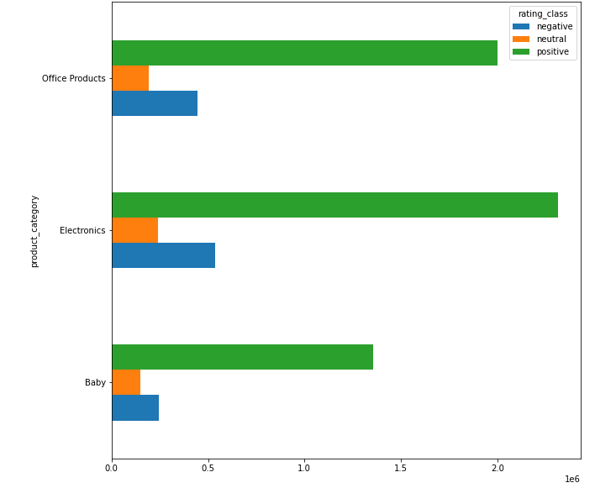
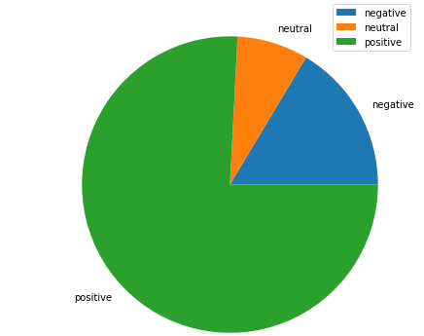

EXPLORATORY DATA ANALYSIS CONTINUED

Slide 21
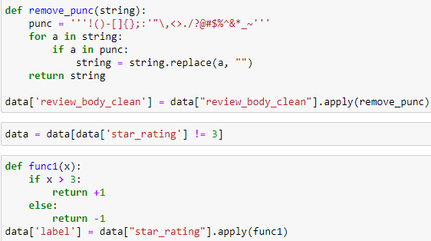
MODEL ANALYSIS

Slide 22
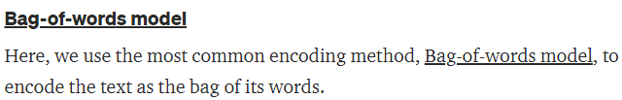
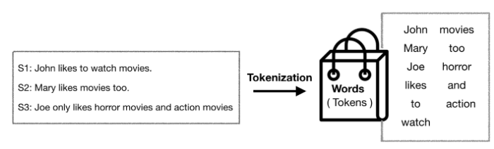
MODEL ANALYSIS CONTINUED

Slide 23

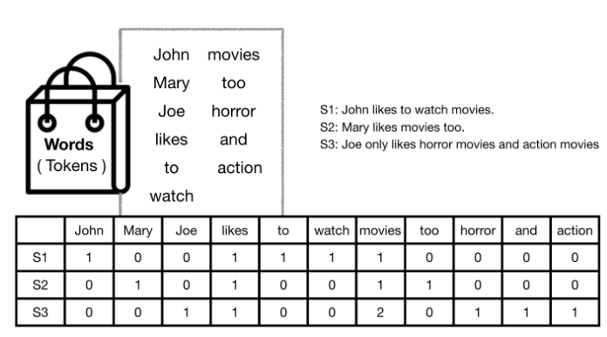
MODEL ANALYSIS CONTINUED
Illustration how vectorization is done using the Bag of words model

Slide 24
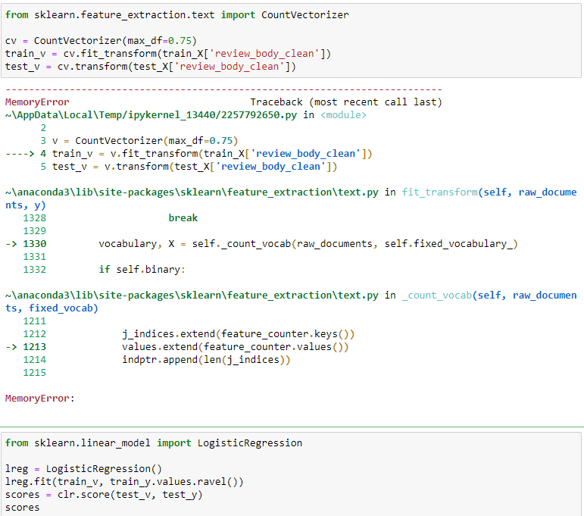
MODEL ANALYSIS CONTINUED
When I tried working with the whole data directly, we got a MemoryError shown here, so I decided to take a random sample of 50000 from our data which we called sdata and worked with this.

Slide 25

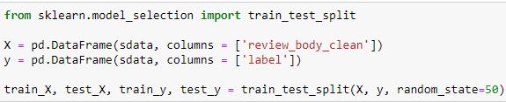
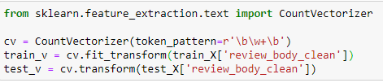
MODEL ANALYSIS CONTINUED

Slide 26
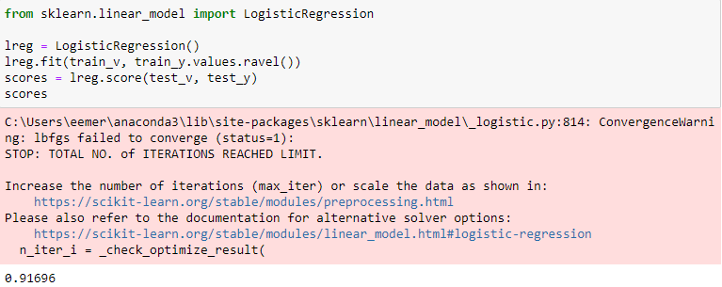
MODEL ANALYSIS CONTINUED

Slide 27
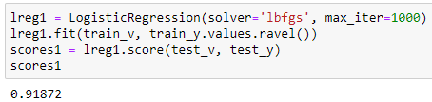
MODEL ANALYSIS CONTINUED

Slide 28
REFERENCES
1. ITC 686 course materials: https://blackboard.cmich.edu/ultra/courses/_202035_1/cl/outline
2. https://towardsdatascience.com/sentiment-analysis-using-logistic-regression-and-naive-bayes-16b806eb4c4b
3. https://medium.com/@qempsil0914/machine-learning-nlp-text-classification-with-amazon-review-data-using-python3-step-by-step-3fb0cc0cecc1
4. https://pymongo.readthedocs.io/en/latest/tutorial.html#querying-for-more-than-one-document
5. https://kavita-ganesan.com/how-to-use-countvectorizer/#.Ymu6S9rMJaZ

Slide 29
THANK YOU

